Slide 1

Phase5 SW Release Plan
Roger Xu, Jiajia Zhou
Date: June 16, 2021
Desired Outcome
Awareness
Decision
Escalation Help
Think
Point of view
Plan to Implement
Implement

Slide 2
Phase 5 Vehicles Timeline
2021 | 2022 | 2023 | 2024
1 | 2 | 3 | 4 | 5 | 6 | 7 | 8 | 9 | 10 | 11 | 12 | 1 | 2 | 3 | 4 | 5 | 6 | 7 | 8 | 9 | 10 | 11 | 12 | 1 | 2 | 3 | 4 | 5 | 6 | 7 | 8 | 9 | 10 | 11 | 12 | 1 | 2 | 3 | 4 | 5 | 6
CDX707
UPV1
UPV2
PA
FDJ
DCV
PEC
FEC
TT
PP
MP1
MP2
OKTB
07/14
08/20
02/02
02/19
06/11
06/13
07/25
08/24
11/09
02/01
03/01
03/28
CDX747
UPV1
FDJ
DCV
PEC
FEC
PP
MP1
MP2
OK2B
UPV2
TT
03/13
06/12
11/06
07/13
01/11
07/11
11/01
10/09
11/29
10/26
12/12
U611MCA
UPV0
UPV1
UPV2
PA
FDJ
DCV
PEC
FEC
HB
TT
PP
MP1
OKTB
03/12
06/11
09/24
10/17
12/03
06/13
10/07
11/04
02/28
06/13
09/05
12/06
01/23
CX788
UPV0
UPV1
UPV2
PA
FDJ
DCV
PEC
FEC
TT
PP
MP1
MP2
OK2B
01/07
10/14
12/29
12/21
06/27
05/10
08/16
11/08
12/08
06/13
11/23
03/14
03/01
05/03
04/29
05/31
U718
UPV0
UPV1
UPV2
PA
FDJ
DCV
PEC
FEC
TT
PP
MP1
MP2
OK2B
11/02
04/26
04/18
10/23
03/11
04/22
08/03
02/23
10/24
03/07
08/07
04/08
02/15
U625MCA
UPV0
UPV1
UPV2
PA
FDJ
DCV
PEC
FEC
HB
TT
PP
MP1
OKTB
03/12
06/11
09/24
10/17
12/03
06/13
10/07
11/04
02/28
06/13
09/05
12/06
01/23
Phase5 Scope
Program | PMT5 | Nameplate | Manufacture | J1 | OKTB | EE Architecture | Centerstack Size | Cluster |  | TCU | ECG
CDX707 | Yang Youfei, Xu Fiona | Nautilus | CAF | 3/28/2023 | 3/28/2023 | FNV3 | 23.6(Pano-Non touch)*2&11.1(Controller-Touch) |  | Landscape | Boundle6 | ECG2
CX788 | He Sylvia | Ford | CAF | 4/26/2023 | 6/21/2023 | FNV2 | 15.3 | NA, AR HUD | Landscape | Boundle5 | ECG2
CDX747 | Yang Frank | Lincoln | BU | 6/12/2023 | 11/6/2023 | FNV3 | 23.6(Pano-Non touch)*2&11.1(Controller-Touch) |  | Landscape | Boundle6 | ECG2
U611 MCA | Yang Frank | Aviator | CAF | 12/6/2023 | 1/23/2024 | FNV3 | 27 | 12.3，Standalone HUD | Landscape | Boundle6 | ECG2
U625MCA | Yang Frank | Explorer | CAF | 12/6/2023 | 1/23/2024 | FNV3 | 27 | 12.3，Standalone HUD | Landscape | Boundle6 | ECG2
U718 | Yang Frank | Navigator | BU | 3/11/2024 | 4/22/2024 | FNV3 | 23.6(Pano-Non touch)*2&11.1(Controller-Touch) |  | Landscape | Boundle6 | ECG2

Slide 3
CDX707 SW Release Plan @06/15
2021 | 2022 | 2023
1 | 2 | 3 | 4 | 5 | 6 | 7 | 8 | 9 | 10 | 11 | 12 | 1 | 2 | 3 | 4 | 5 | 6 | 7 | 8 | 9 | 10 | 11 | 12 | 1 | 2 | 3 | 4 | 5 | 6 | 7 | 8 | 9 | 10 | 11 | 12
CDX707 VPP
UPV2
PEC
UPV1
PA
FDJ
DCV
FEC
TT
PP
MP1
MP2
OKTB
02/19
06/11
07/14
08/20
02/02
06/13
07/25
08/24
11/09
02/01
03/28
CDC AHU HW
PEC1
FEC1
03/01
08/02-08/30
12/05-02/28
05/15-06/15
Pre-DV
DV1
DV2
07/26
A0 PCBA
01/25
A1
06/15
B0
11/30
B1 DV2
05/10
09/06
Display(23.6+23.6,11.1 touch)
09/30-10/30
12/05-12/11
23.6 Pre-DV
03/22-06/09
11.1 EMC
23.6 DV
SW Release for CAF/FO
DCV0
11/03
DCV1
12/29
DCV2
01/26
DCV3
03/09
R00
04/06
R04
06/01
R05
06/29
R05.1
07/27
R07
12/04
R08 for OKTB
01/24
R09 for OTA
04/28 TBD
R01
05/04
R05.2
08/24
R06.1
11/02
DCV Beta
08/02
R06
09/21
SW Release for REC
Spring Festival
National Day
Spring Festival
National Day
Spring Festival
DCV Alpha
03/19
DCV Beta1
08/18
DCV Beta2
09/15
R04
05/18
R05
06/15
R05.1
07/13
R06
09/07
R06.1
10/19
R07
11/20
R08 for OKTB
01/15
DCV Alpha1
03/31
DCV Alpha2
04/28
DCV Alpha3
05/26
DCV Alpha4
06/23
DCV Beta
07/18
08/01
DCV0
10/20
DCV0.1
11/17
DCV1
12/15
DCV2
01/12
DCV3
02/23
R00
03/23
R01
04/20
R05.2
08/10
Vendor Integration
R04
04/20
R06.1
09/07
R07
10/19
R08 for OKTB
12/15
DCV Alpha0
02/23
DCV Alpha1
03/03
DCV Alpha2
03/31
DCV Alpha3
04/28
DCV Alpha4
05/26
DCV Beta
06/20
07/02
DCV Beta1
07/21
DCV Beta2
08/18
DCV0
09/15
DCV0.1
10/20
DCV1
11/17
DCV2
12/15
DCV3
01/12
R00
02/23
R01
03/23
R05
05/18
R05.1
06/15
R05.2
07/13
R06
08/10
UX Release
Group A
03/15 sign-off UE
05/05 Stagger UI
05/19 sign-off UI
Group B
04/30 UE
06/02 stagger UI
06/16 sign-off UI
Group C 05/21 UE
08/17 UI
Group D
06/15 UE
09/15 UI
TBD
SYNC+ MCU USB Update
SYNC+ MCU OTA Update
Cluster SOC USB Update
Cluster MCU OTA Update
Rocket Setup
CCS – UFM/PTE
IP Pass Through Client
Eng version for vendor’s internal release and test.
FNVx Release
SOA Gateway
Wireless Interface Router
IVI Provisioning
Bezel Diagnostics(SOA related)
Diagnostic_ Analytic
CCS –Authorization
USB Update of TCU/ECG
SYNC+ SOC USB Update
SYNC+ SOC OTA Update
Eng version not necessary to release.
Pro version released for REC, focus and lite test.
ITV Test
03/23-07/30
Pro version released for REC, full test.
Purchase process
Net/Diag develop~4.5months
Bug fix ~1.5m
Vendor P1 test ~2.5 m
P2 Log Prepare ~2m
We are here
Net/Diagnostic full function 12/15 for DCV2
Net/Diag Bug fix
For R00
01/30
ITV P1 Release for R04
04/15
ITV P2 complete 07/18
Report Review 07/25

Slide 4
CX788 SYNC+/AR-HUD/Display Plan @06/07
2021 | 2022 | 2023
1 | 2 | 3 | 4 | 5 | 6 | 7 | 8 | 9 | 10 | 11 | 12 | 1 | 2 | 3 | 4 | 5 | 6 | 7 | 8 | 9 | 10 | 11 | 12 | 1 | 2 | 3 | 4 | 5 | 6 | 7 | 8 | 9 | 10 | 11 | 12
CX788 VPP
UPV0
UPV1
UPV2
PA
FDJ
DCV
PEC
FEC
TT
PP
MP1
MP2
OKTB
05/31
08/16
12/08
01/07
10/14
06/27
11/08
06/13
11/23
12/21
03/01
05/31
04/29
Display(15.4)
11/8-12/31
3/30~5/20
Pre DV-1
Ass tooling
Critical DV
TFT T0 Sample
10/30
TFT T1 Sample
12/30
Tier 1 T0 Sample
3/30
Tier 1 T1 sample for DCV 5/20
AR-HUD
2/15~5/15
6/15-9/15
Pre-DV
EMC + DV
T0 Sample
2/15
T1 Sample
6/1
TFT HUD
CDC AHU HW
07/25-09/15
01/13-02/20
04/05-05/05
EMC
EMC
03/27-06/27
06/28-07/12
Pre-DV
B0 DV1
07/18
DV1
B1 DV2
01/06
DV2
PV
PPAP
A Sample Pre-DV
12/15
09/15
B Sample Pre-DV
02/25
07/25-11/02
01/13-03/20
GPDS SW Version for MRD
R04
02/05
R08
07/14
DCV Beta
04/14
DCV0
07/14
R05
03/14
R06
05/14
R07
06/14
SW Release for REC
FIP Draft Release
04/30
DCV1
08/14
R00
12/30
Spring Festival
National Day
Spring Festival
MFL Release
04/15
DCV Alpha
02/28
R08
06/30
DCV Beta
03/30
DCV4
11/15
DCVBeta2
05/30
DCV0
06/30
DCV3
09/30
R00
12/15
R04
01/15
R06
04/30
R07
05/30
Package 1-3-HW+Base SW
DCV Beta1
04/30
DCV1
07/30
DCV2
08/30
R05
02/28
R05.1
03/30
System UI and Launcher UE Sign-off 07/16
Group B UE
09/03
Group A UI
11/26->11/01
R4
12/14
R5
02/28
R6
03/30
R7
04/30
R8
05/30
R9
06/30
R10
07/30
R11
08/30
R12
10/15
R13
11/15
R14
12/15
R15
01/15
R16
02/28
R17
03/30
R18
04/30
R19
05/30
IVI UI Plan
AR HUD UI Plan
Group A UE
07/23
Group C UE
10/15
Group B UI
12/17
Group C UI
01/26
Group D UI
03/27
Eng version released for REC, focus and lite test.
Group A UI
~02/15
Group C UI
~03/15
Pro version support GPDS key node, full test.
We are here
Group C UI
~04/15

Slide 5
CX788 SYNC+/AR-HUD/Display Plan @06/18
2021 | 2022 | 2023
1 | 2 | 3 | 4 | 5 | 6 | 7 | 8 | 9 | 10 | 11 | 12 | 1 | 2 | 3 | 4 | 5 | 6 | 7 | 8 | 9 | 10 | 11 | 12 | 1 | 2 | 3 | 4 | 5 | 6 | 7 | 8 | 9 | 10 | 11 | 12
CX788 VPP
UPV0
UPV1
UPV2
PA
FDJ
DCV
PEC
FEC
TT
PP
MP1
MP2
OKTB
05/31
08/16
12/08
01/07
10/14
06/27
11/08
06/13
11/23
12/21
03/01
05/31
04/29
Display(15.4)
11/8-12/31
3/30~5/20
Pre DV-1
Ass tooling
Critical DV
TFT T0 Sample
10/30
TFT T1 Sample
12/30
Tier 1 T0 Sample
3/30
Tier 1 T1 sample for DCV 5/20
AR-HUD
2/15~5/15
6/15-9/15
Pre-DV
EMC + DV
T0 Sample
2/15
T1 Sample
6/1
TFT HUD
CDC AHU HW
06/10-07/10
01/13-02/20
03/01-04/01
EMC
EMC
03/27-06/27
06/28-07/12
Pre-DV
B0 DV1
05/15
DV1
B1 DV2
01/06
DV2
PV
PPAP
A Sample for SW Dev
09/15
B Sample Pre-DV
02/25
06/10-08/10
01/13-03/20
GPDS SW Version for MRD
R04
02/05
R08
06/17
SW Release for REC
FIP Draft Release
04/30
DCV Beta
02/27
DCV0
06/03
DCV1
07/04
R00
11/11
R05
01/14
R06
03/17
R07
04/17
Spring Festival
National Day
Spring Festival
MFL Release
04/15
R08
05/04
Package 1-3-HW+Base SW
DCV Beta
02/20
DCV0
05/20
DCV1
06/20
R00
10/27
R04
11/27
R05
12/27
R06
03/04
R07
04/04
System UI and Launcher UE Sign-off 07/16
Group B UE
09/03
Group A UI
11/01
Checkpoint 4
R4
12/13
R5
01/13
R6
02/20
R7
03/20
R8
04/20
R9
05/20
R10
06/20
R11
07/20
R12
08/20
R13
09/20
R14
10/27
R15
11/27
R16
12/27
R17
02/04
R18
03/04
R19
04/04
IVI UI Plan
AR HUD UI Plan
Group A UE
07/23
Group A UI Delivery
10/10
Checkpoint 3
Group B UI
12/17
Group C UI
01/07
Group D UI
03/27
Eng version released for REC, focus and lite test.
Group A UI
~02/15
Group C UI
~03/15
Pro version support GPDS key node, full test.
We are here
Group C UI
~04/15

Slide 6
CDX747 SW Draft Release Plan @03/12 To be Update
2021 | 2022 | 2023
1 | 2 | 3 | 4 | 5 | 6 | 7 | 8 | 9 | 10 | 11 | 12 | 1 | 2 | 3 | 4 | 5 | 6 | 7 | 8 | 9 | 10 | 11 | 12 | 1 | 2 | 3 | 4 | 5 | 6 | 7 | 8 | 9 | 10 | 11 | 12
CDX747
UPV0
UPV1
UPV2
FDJ
DCV
PEC
FEC
TT
PP
MP1
MP2
OK2B
01/11
03/13
06/12
10/09
CDC AHU HW
04/06
07/13
10/26
07/11
11/01
11/29
12/12
11/06
12/01-1/05
4/1-6/1
10/20-11/20
A Pre-DV
11/10
Pre-DV
B0 DV1
3/10
DV1
DV2
HW Request Frozen
7/13
B1 DV2
9/20
Display(23.6+23.6,11.1 touch)
09/30-10/30
12/05-12/11
23.6 Pre-DV
03/22-06/09
11.1 EMC
23.6 DV
GPDS SW Version for MRD
DCV Beta
12/15
DCV2
07/05
R04
10/17
R06
02/13
R07 05/06
SW Release for REC
DCV0
04/10
DCV1
05/10
DCV3
08/11
R00
9/15
R05
11/06
National Day
Spring Festival
National Day
Spring Festival
MFL Release
04/30
FIP Draft Release
05/30
R28
07/28
R25
04/28
R29
08/28
R30 for OKTB
09/28
R15
05/18
R16
06/15
R17
07/13
R19
09/07
R20
10/19
R21
11/20
R22
01/15
R23
02/28
R24
03/28
R7
09/15
R8
10/20
R9
11/17
R10
12/15
R11
01/12
R12
02/23
R13
03/23
R14
04/20
R18
08/10
R27
06/28
R26
05/28
Package 1-HW+Base SW
R15
04/20
R20
09/07
R21
10/19
R22
12/15
R7
08/18
R8
09/15
R9
10/20
R10
11/17
R11
12/15
R12
01/12
R13
02/23
R14
03/23
R16
05/18
R17
06/15
R18
07/13
R19
08/10
Package 2-Ford core service
R15
04/20
R20
09/07
R21
10/19
R22
12/15
R7
08/18
R8
09/15
R9
10/20
R10
11/17
R11
12/15
R12
01/12
R13
02/23
R14
03/23
R16
05/18
R17
06/15
R18
07/13
R19
08/10
Package 3-Eco APPs
R15
04/20
R20
09/07
R21
10/19
R22
12/15
Eng version for vendor’s internal release and test.
R7
08/18
R8
09/15
R9
10/20
R10
11/17
R11
12/15
R12
01/12
R13
02/23
R14
03/23
R16
05/18
R17
06/15
R18
07/13
R19
08/10
Inhouse APPs
Eng version not necessary to release.
R15
04/20
R20
09/07
R21
10/19
R22
12/15
Pro version released for REC, focus and lite test.
R7
08/18
R8
09/15
R9
10/20
R10
11/17
R11
12/15
R12
01/12
R13
02/23
R14
03/23
R16
05/18
R17
06/15
R18
07/13
R19
08/10
Package 4-HMI
Pro version released for REC, full test.
Group A for DCV Beta
06/15 UI
Group B for DCV Beta
07/13
Group C for DCV0
08/30
Group D for DCV2
10/26
Notes:
有功能增加；
音频架构有变化。

Slide 7
U611MCA SW Release Plan @06/02
2021 | 2022 | 2023
1 | 2 | 3 | 4 | 5 | 6 | 7 | 8 | 9 | 10 | 11 | 12 | 1 | 2 | 3 | 4 | 5 | 6 | 7 | 8 | 9 | 10 | 11 | 12 | 1 | 2 | 3 | 4 | 5 | 6 | 7 | 8 | 9 | 10 | 11 | 12
U611MCA
UPV0
UPV1
UPV2
FDJ
DCV
PEC
FEC
HB
TT
PP
MP1
OK2B
1/23
03/16
06/11
9/24
12/3
06/13
10/07
11/04
2/28
6/13
09/5
12/06
CDC AHU HW
12/10-02/21
03/21-05/21
9/20-11/01
HW Request Frozen
6/11
A1 Pre-DV
11/15
Pre-DV
B0 DV1
3/10
DV1
B1 DV2
8/20
DV2
A0 08/01(TBC) for SW debug
Display(12.3+27 TOUCH)
01/27
05/05
EMC
DV
SW Release for CAF/FO
DCV Beta
12/03
DCV0
03/13
R04
9/15
SW Release for REC
DCV1
04/13
R00
8/15
R04.1
01/15
R05
4/13
R06
07/05
R07 9/30
R08 12/30
National Day
Spring Festival
National Day
Spring Festival
MFL Release
04/30
FIP Draft Release
05/30
DCV Alpha1
10/19
DCV Beta
11/19
DCV0
02/26
DCV1
03/27
R00
07/27
R04
09/01
R04.1
12/30
R05
03/30
R06
06/20
R07
09/15
R08
12/15
Vendor Integration
DCV Alpha
07/18
DCV Alpha1
09/12
DCV Beta
10/19
DCV Beta1
11/19
DCV Beta2
12/19
DCV0
01/21
DCV1
02/23
DCV2
03/27
DCV3
04/27
DCV4
05/27
R00
06/27
R04
07/27
R04.1
11/30
R04.1
02/20
R06
05/20
R07
08/15
R08
11/15
UX Release
Group A UE
04/15
Group A UI
07/01
Group B UI
09/04
Group C for 11/01
Group D before FDJ
12/01
USB Update of TCU/ECG
SYNC+ SOC USB Update
SYNC+ SOC OTA Update
FNVx Release
SOA Gateway
Wireless Interface Router
IVI Provisioning
Bezel Diagnostics(SOA related)
Diagnostic_ Analytic
CCS –Authorization
CCS – UFM/PTE
IP Pass Through Client
SYNC+ MCU USB Update
SYNC+ MCU OTA Update
Cluster SOC USB Update
Cluster MCU OTA Update
Rocket Setup
Eng version for vendor’s internal release and test.
Eng version not necessary to release.
ITV Test
Pro version released for REC, focus and lite test.
Pro version released for REC, full test.
Notes:
有功能增加；
音频架构有变化。

Slide 8
Phase5 SYNC+ 3.0 Timeline Draft To Be Reviewed
1 | 2 | 3 | 4 | 5 | 6 | 7 | 8 | 9 | 10 | 11 | 12 | 1 | 2 | 3 | 4 | 5 | 6 | 7 | 8 | 9 | 10 | 11 | 12 | 1 | 2 | 3 | 4 | 5 | 6 | 7 | 8 | 9 | 10 | 11 | 12
Key Checkpoint
1. Supplier Sourced (SOBD)
======
1.Bill of feature(MFL) Finalized
2.Platform feature spec complete and cascaded
3.Function Safety Concept updated and completed
4.Cybersecurity Requirements Identified
5.UX(UEUI) alignment confirmed
6.SW environment and baseline Design
1.DCV Beta verified supporting Pre-DV/EMC, critical function including Climate/Camera/Radio/Music/Video/Navigation/Speed meter/Driving Info etc.
2.Feature Software early system-level integration test start at <FDJ> breadboard
3. UX doc sign off by HMI/Studio team
1All design verification testing completed by <PEC>
2.Feature Software system-level integration test complete and sign off by feature owner and HMI team
3.R00 release for <PEC> without critical blocker issue,
4.Diagnostics Part2 DV(iTV) test report shows 100% passed
1.Bill of feature Initialized(MFL)
2.Feature Owner confirmation
3. Basic Level spec are available
1. Agile feature full function Integration without critical bug.
1. Software OTA window preserved post Job1 and before OKTB.
1. Platform feature spec finalization and sign off
2.Simulate feature integration of interfaces, states and responses to requested behavior
3. Early test of new and C/O features with physical parts
1.DCV1 verified supporting DV/EMC/DCV MRD with full function code completed.
2.Feature Software early system-level integration test complete by <DCV> breadboard, verify feature functionality and performance requirements.
Project VPP
UPV1
UPV2
PA
FDJ
DCV
PEC
FEC
TT
PP
MP1
MP2
PS/PSC
UPV0
OKTB
UX Release
6 weeks
Group A UI
For Pre DV/FDJ
Group B UI
For Critical DV/DCV
Group C UI
For DCV
Group D UI
For DCV/PEC
DCV Critical Path * 45 weeks
>=14 weeks
>=32 weeks
Group A Features Coding based on UI
DCV Alpha
DCV Beta
test
Eng Version
DCV0
test
A1
Pre DV
Hardware
Debug
B0
Critical DV
A0 PCBA
A1 Sample
B0 Sample
B1 Sample
17 weeks(4 months)
4 weeks
5 weeks
>=6 weeks
9 weeks
9 weeks
9 weeks
>=6 weeks
GPDS SW Version for MRD
5 weeks
DCV
DCV Beta
DCV0
DCV1
DCV MRD
R00
R05
R06
R07
R04
R08
Display light up
Platform Arch design
PIPELINE Design
Features and HMI Design
Initial release for Pre DV
DCV Beta
30% Coding
Release Fundamental features for DCV vehicle testing
DCV1
60% Coding
Zero IG defects supporting PEC sign off
R00
95% Coding(Not including Agile features)
Delivery of all features with zero G issues
R05 100% Coding
AIMS Issue solve / Bug fix
R06 100% Coding
AIMS Issue solve / Bug fix
R07 100% Coding
Hotfix for OKTB
10weeks(2.5months)
8weeks(2months)
17 weeks(4months)
17 weeks(4months)
13 weeks(3months)
8weeks(2months)
9 weeks(2months)
Preserved

Slide 9
SYNC+ 3.0 DCV/PEC/J1 Critical Path
China Accelerated SW Plan ---DCV Critical Path
45 weeks
Group A UI Release
DCV Beta 30%
DCV0 50%
DCV1 60%
FDJ
DCV
Group A Features Coding based on UI
DCV Alpha
DCV Beta
Test
A Sample
Pre DV
Debug
B Sample
Critical DV
MRD
Display light up
Platform Arch design
PIPELINE Design
Features and HMI Design
Initial release for Pre DV
DCV Beta
30% Coding
Release Fundamental features for DCV vehicle testing
DCV1
60% Coding
10weeks(2.5months)
8weeks(2months)
17 weeks(4months)
China Accelerated SW Plan ---PEC/J1 Critical Path
4 weeks
5 weeks
6 weeks
6 weeks
9 weeks
9 weeks
9 weeks
DCV
DCV
PEC
FEC
TT
PP
J1
OKTB
DCV1
DCV MRD
R00
R04
R05
R06
R07
R08
Zero IG defects supporting PEC sign off
R00 (4*SW iterated versions )
95% Coding(Not including Agile features)
Delivery of all features with zero G issues
R05 100% Coding for TT MRD
AIMS Issue solve / Bug fix
R06 100% Coding for PP MRD
AIMS Issue solve / Bug fix
R07 100% Coding for J1
Hotfix for OKTB
R08 100% Coding
17 weeks(4months)
13 weeks(3months)
8weeks(2months)
8 weeks(2months)
Preserved

Slide 10
CDX707/788 SW Release Requirement for MRD
CDX707
R-Event | Software Maturity | Corresponding Milestone | Release Due Date^{*1)} | Build Support
TPB | Fully verified on component level | TPV BB MRD - 1 week | 9/9/2019 | Support TPV BB and TPV T&C MRD
TP3 | Updates Release | TDC - 2weeks | 1/22/2021 | Support TDC
DCV beta | System test on engineering prototype | eBB MRD | 8/20/2021 | Support FDJ
DCV 0 | Fully verified on component level | DCV BB MRD - 4 weeks | 11/10/2021 | Support <DCV BB> MRD and HiL MRD
DCV 1 | Updates Release | T/C MRD - 4 weeks | 12/8/2021 | Support <T/C> MRD
DCV 2 | Updates Release | DCV - 2 weeks | 1/19/2022 | Breadboard update, DCV vehicles update
DCV 3 | Updates Release | DCV+ 4 weeks | 3/2/2022 | Breadboard update, DCV vehicles update
R00 | Feature DV complete. | PEC - 6 weeks | 5/2/2022 | DCV vehicles update for PEC Sign-off
R04 | Feature DV signed off | FEC - 6 weeks | 6/13/2022 | DCV vehicles update for FEC Sign-off
R05 | Fully Validated Release | TT MRD - 4 weeks | 7/13/2022 | Support <TT> MRD
R06 | Fully Validated Release | PP MRD - 4 weeks | 9/28/2022 | Support <PP> MRD
R07 | Fully Validated Release | MP1/J1 MRD - 4 weeks | 12/6/2022 | Support <MP1> MRD
R-Event | Software Maturity | Corresponding Milestone | Release Due Date*1) | Build Support
TPB | Fully verified on component level | TPV BB MRD - 1 week | NA | Support TPV BB and TPV T&C MRD
TP3 | Updates Release | TDC - 2weeks | 7/30/2021 | Support TDC
DCV beta | System test on engineering prototype | eBB MRD | 1/7/2022 | Support FDJ
DCV 0 | Fully verified on component level | DCV BB MRD - 4 weeks | 3/21/2022 | Support <DCV BB> MRD and HiL MRD
DCV 1 | Updates Release | T/C MRD - 4 weeks | 5/4/2022 | Support <T/C> MRD
DCV 2 | Updates Release | DCV - 2 weeks | 5/30/2022 | Breadboard update, DCV vehicles update
DCV 3 | Updates Release | DCV+ 4 weeks | 7/11/2022 | Breadboard update, DCV vehicles update
R00 | Feature DV complete. | PEC - 6 weeks | 9/2/2022 | DCV vehicles update for PEC Sign-off
R04 | Feature DV signed off | FEC - 6 weeks | 10/12/2022 | DCV vehicles update for FEC Sign-off
R05 | Fully Validated Release | TT MRD - 3 weeks | 11/24/2022 | Support <TT> MRD
R06 | Fully Validated Release | PP MRD - 4 weeks | 1/26/2023 | Support <PP> MRD
R07 | Fully Validated Release | MP1/J1 MRD - 4 weeks | 4/1/2023 | Support <MP1> MRD

Slide 11
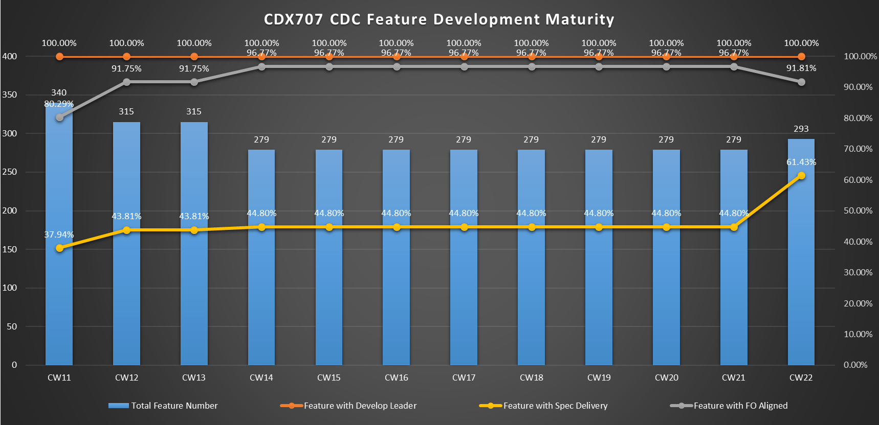
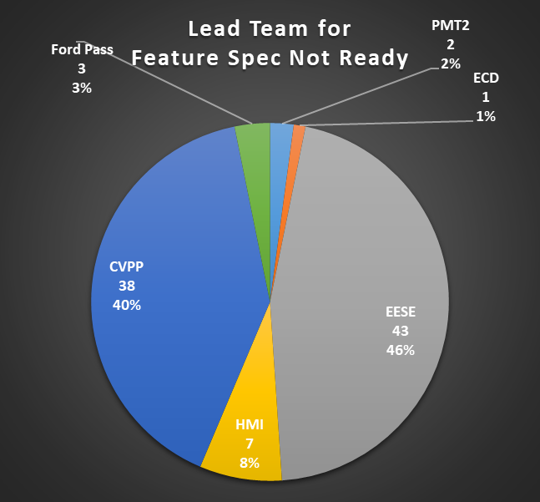
CDX707 SW Maturity Chart @0524

Slide 12
Backup material

Slide 13
Phase 5 Vehicles Timeline Between CX788 & Accelerated VPP
China Accelerated SW Plan
45 weeks
Group A UI Release
DCV Beta 35%
DCV0 80%
DCV1 85%
FDJ
DCV
Group A Features Coding based on UI
DCV Alpha
DCV Beta
Test
A Sample
Pre DV
8'' HUD
15.3''
Debug
B Sample
Critical DV
Phase5 CDX788
smart surface
MRD
45 weeks
Group A UI Release 7/06(Per Template)
Group A UI
08/15(SW Expected)
Group A UI
11/01(HMI Feedback)
40 weeks
FDJ
DCV Beta 35% 03/30
MRD
DCV
DCV0 80% 06/24
DCV1 85% 07/24
5 weeks Gap
10 weeks Gap
01/07
IP MRD 05/06
06/13
Group A Features Coding based on UI
02/15
03/15
03/30
10+5 WKS Gap
DCV Alpha
DCV Beta
Test
04/07-06/07
10 WKS Gap
A Sample
Pre DV
07/13
07/13-08/31
Debug
B Sample
Critical DV
15.4” Display
6/30
8/30
11/8-12/31
12/15-3/15
3/30~5/20
EC Approval
Tier 2 TFT Tooling KO
Included PCBA
Pre DV-Round 1
Tier 1 assembly tooling KO
EMC + Critical DV
TFT T0 Sample
10/30
TFT T1 Sample
12/30
Tier 1 T0 Sample
3/30
Tier 1 T1 sample for DCV 5/20
AR-HUD
6/30
9/15
11/15
2/15~5/15
6/15-9/15
EC Approval
Windshield surface/HUD package frozen
Tooling KO
Pre-EMC + critical DV
EMC + DV
T0 Sample
2/15
T1 Sample
6/1

Slide 14
CDX707 HW and SW Design & Validation Plan
2021 | 2022 | 2023
VPP
1 | 2 | 3 | 4 | 5 | 6 | 7 | 8 | 9 | 10 | 11 | 12 | 1 | 2 | 3 | 4 | 5 | 6 | 7 | 8 | 9 | 10 | 11 | 12 | 1 | 2 | 3 | 4 | 5
12/22
1/19
05/30
07/11
08/10
11/02
Ver. 20210224
UPV1
UPV2
PA
FDJ
DCV MRD
DCV
PEC
FEC
TT
PP
MP1
MP2
3
03/05
06/16
07/14
08/20
02/02
06/13
07/25
08/24
11/09
02/01
03/01
2
01/05
Checkpoint
3/30
Hero S
5/5
Group A
6/16
UPV2
SYNC+ DEVELOPMENT
6/1
Group C
7/1
VPP
TT Containment:
Aligned with NMP: SYNC+ HW & SW w/ PEC signed off to support TT build. Potential TT retrofit 2 wks post TT required to contain critical DV test failure
TT/PP VOCF 2 shift to support robust SW & HW delivery
Root cause & Countermeasure
06/07–7/10
07/13-9/13
Debug & Build
10/21-12/15
12/21-4/5
4/18-06/06
07/12-10/21
HMI
SYNC+ Build
&Validation
Pre-DV
Critical DV
SYNC+ CDC DV
Sample Build
Re-DV
TT Build & PV
Vehicle level test/sign off
PSW
12/15
(HMI)
3/15
(HMI)
DCV2(R11 Eng)
DCV3(R12 Eng)
10/29
HMI 12wks delayed
Current plan
DV Test Impact & Opp.:
By R10 Feb. 22, 20 DCVs built w/ 4 plan to be shipped out at Feb. 15 for US Calibration
Further discussion with Cal to align the containment plan if defer 4 Cal. DCVs 1wk with right level HW & SW
Study to build DCV in 2 lines or add more DCVs to reduce build time
SW Release
DCV Beta(R5 Eng)
07/10
(Pre-DV)
DCV0(R8 Eng)
10/20
（Critical DV)
DCV1(R10 Eng)
12/20
R00(R13 Eng) 04/06
(DCV build and PEC sign off)
R04(R15 Eng) 06/01
（Re-DV）
Compress Development timing and stagger DCV software to 3 version (R10/11/12) to support PEC/FEC sign off to contain HMI 12wks delay
Root cause & Countermeasure
08/02-09/05
SYNC+ Build
&Validation
09/13-11/18
Debug & Build
12/24-2/22
2/22 – 5/27
06/10-08/01
09/12-12/21
Pre-DV
Critical DV
SYNC+ CDC DV
Sample Build
Re-DV
TT build & PV
DCV Opportunity:
R8 ilo R10 to support DCV build w/ downstream test hold till R10 ready
CDC module retrofit takes 44 minutes only with control screen, lower vent and floor console disassembled
HMI
Vehicle level test/sign off
PSW
Critical DV can’t complete by DCV MRD. (7wks gap)
12/29
New plan
3/15
5/19
DCV2(R11 Eng)
DCV3(R12 Eng)
6wks
6wks
7wks
HMI 8wks delay
SW Release
DCV Beta(R5 Eng)
09/10
DCV0(R8 Eng)
12/20
（Critical DV)
DCV1(R10 Eng)
R10 2/22
R00(R13 Eng) 06/06
R04(R15 Eng) 08/01
（Re-DV）
3wks
(DCV reflash)
(DCV build and vehicle test/sign off)
1
To ensure robust and quality delivery no timing opportunity could be further compressed, downstream engineering work postponed by 8wks
Proposed resolution:
< DCV>: Retrofit SYNC+ HW with R10 SW on 22-Feb-2022.
<PEC><FEC> ><PSW>: Stagger milestone for SYNC+& related features.
<TT>: Check point at PEC 08/01 for SYNC+ retrofit on vehicle.
Pre-DV:
Preliminary DV and debug for basic functions of platform.
Hand build prototype sample (w/ ~30% design completion)
Test setup trail run
Test at none Ford certified Lab.
Critical DV:
Safety function validation(Speed, PRND, Fuel, Telltale, RVC, Climate, ESP/ADAS setting), EMC/thermal/Key off load, High/Low temperature operation
DCV off-tool sample
Ford certified Lab.
DCV1
PEC1
FEC1
PSW
02/22
07/26
09/06
12/29

Slide 15
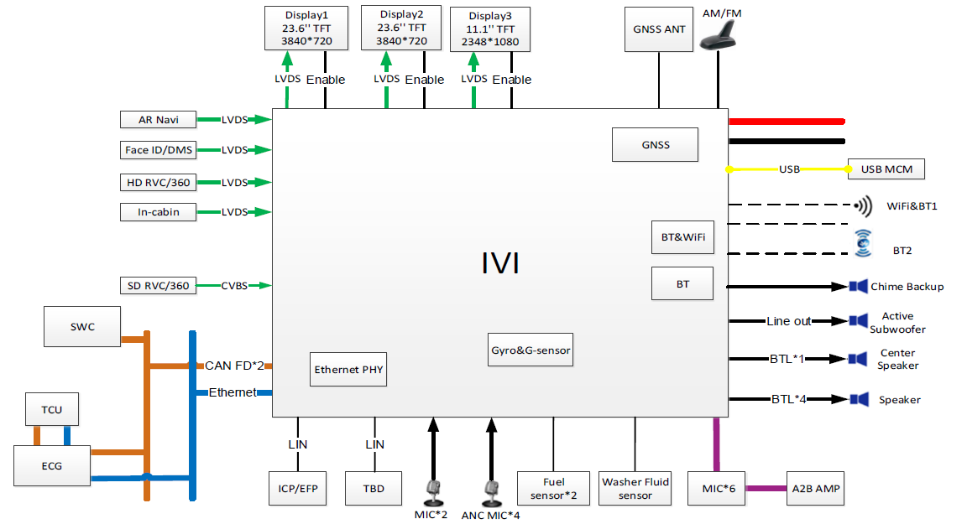
CDX707 System Block Diagram
2021 | 2022 | 2023

Slide 16
CDX707 Software and Autosar Release Plan
2021 | 2022 | 2023
1 | 2 | 3 | 4 | 5 | 6 | 7 | 8 | 9 | 10 | 11 | 12 | 1 | 2 | 3 | 4 | 5 | 6 | 7 | 8 | 9 | 10 | 11 | 12 | 1 | 2 | 3 | 4 | 5 | 6 | 7 | 8 | 9 | 10 | 11 | 12
CDX707 VPP
UPV2
PEC
UPV1
PA
FDJ
DCV
FEC
TT
PP
MP1
MP2
OKTB
02/19
06/11
07/14
08/20
02/02
06/13
07/25
08/24
11/09
02/01
03/28
CDC AHU HW
PEC1
FEC1
03/01
08/02-08/30
12/05-2/28
05/15-06/15
Pre-DV
DV1
DV2
07/26
A0 PCBA
01/25
A1 PCBA
05/30
06/08
B0 DV1
11/30
B1 DV2
05/10
09/06
SW Release for CAF/FO
DCV0
11/03
11/10
DCV1
12/29
12/15
DCV2
01/26
01/14
DCV3
03/09
02/25
R00
04/06
05/02
R04
06/01
06/13
R05
06/29
07/14
R05.1
07/27
R07
12/04
12/14
R08 for OKTB
01/24
R09 for OTA
04/28 TBD
R01
05/04
R05.2
08/24
R06.1
11/02
DCV Beta
08/02
08/20
R06
09/21
09/29
SW Release for REC
Spring Festival
National Day
Spring Festival
National Day
Spring Festival
DCV Alpha
03/19
DCV Beta1
08/18
DCV Beta2
09/15
R04
05/18
R05
06/15
R05.1
07/13
R06
09/07
R06.1
10/19
R07
11/20
R08 for OKTB
01/15
DCV Alpha1
03/31
DCV Alpha2
04/28
DCV Alpha3
05/26
DCV Alpha4
06/23
DCV Beta
07/18
08/01
DCV0
10/20
DCV0.1
11/17
DCV1
12/15
12/07
DCV2
01/12
01/07
DCV3
02/23
02/11
R00
03/23
R01
04/20
R05.2
08/10
YF Package integration
DCV Alpha4
05/26
DCV Beta
06/20
07/04
DCV Beta1
07/18
DCV Beta2
08/18
DCV0
09/15
Autosar Package integration
T：07/30
DCV0
09/15
DCV0.1
10/20
DCV1
11/17
DCV2
12/15
DCV3
01/12
R00
02/23
R01
03/23
R04
04/20
R05
05/18
R05.1
06/15
R05.2
07/13
R06
08/10
R06.1
09/07
R07
10/19
R07 for OKTB
12/15
完成调查表，2周
完成德国报价，2周
预估项目定点
YF内部流程PR&PO，签订采购合同
6周
Vector释放软件包，10周
网络诊断初版
移植完成之前CAN信号,实现30%的CAN信号添加
网络诊断全功能，FBL并行开发
Bug Fix
ITV P1
ITV P2
完成ITV
注：
DCV ALPHA4 – R06 详细释放计划见后页
YF CAN 网络信号分3个版本释放
- 10/20(DCV0.1集成时间)释放30%信号(即整体信号30%),包括移植先前开发的CAN信号(YF自研包开发的信息)。
- 11/17(DCV1集成时间)释放30%信号(即整体信号60%)
- 12/15(DCV2集成时间)释放40%信号(即整体信号100%)
此外还需考虑Package2调试和集成时间。
ITV认证周期： T(2021/07/30) +12月, 完成认证时间2022/07/25
实现60%的CAN信号的添加，30%的DID和30%的DTC的实现

Slide 17
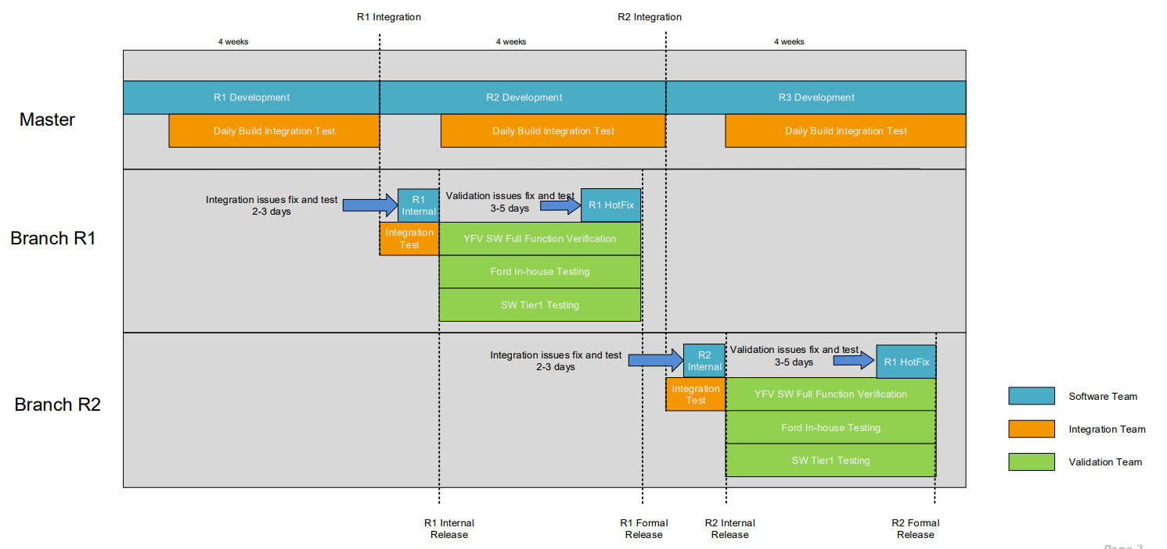
Phase5 SW Integration and Release Rule
2021 | 2022 | 2023
Checkpoint2:
Eng SW Release for REC
Checkpoint1:
Vendor Integration
Checkpoint3:
Pro SW Release for CAF/FO

